Slide 1




Boilers
Boiler is defined as a closed metallic vessel in which water is heated beyond the boiling stage by the application of heat liberated by the combustion of fuels and converted into steam.
Function:
Supply the steam at required constant pressure with its quality either dry, or nearly as dry, or superheated.
Steam can be supplied at constant pressure by maintaining the steam generation rate and steam flow rate equal.

Slide 2
Classification on the basis of Principle of Working
1) Fire Tube Boilers:
Hot flue gases produced by the combustion of fuels are led through a nest of tubes around which the water circulates
Suitable for steady working pressures upto 20 bar.
Examples are Cochran boiler, Cornish boiler, Lancashire boiler, Locomotive boiler and Scotch Marine Boiler.

Slide 3
Classification on the basis of Principle of Working
2) Water Tube Boilers:
Water circulates inside the tubes while the hot gases produced by the combustion of fuels pass over them externally
More suitable for generation of steam at very high pressures.
Examples are Babcock and Wilcocx Boiler, Stirling Boiler

Slide 4
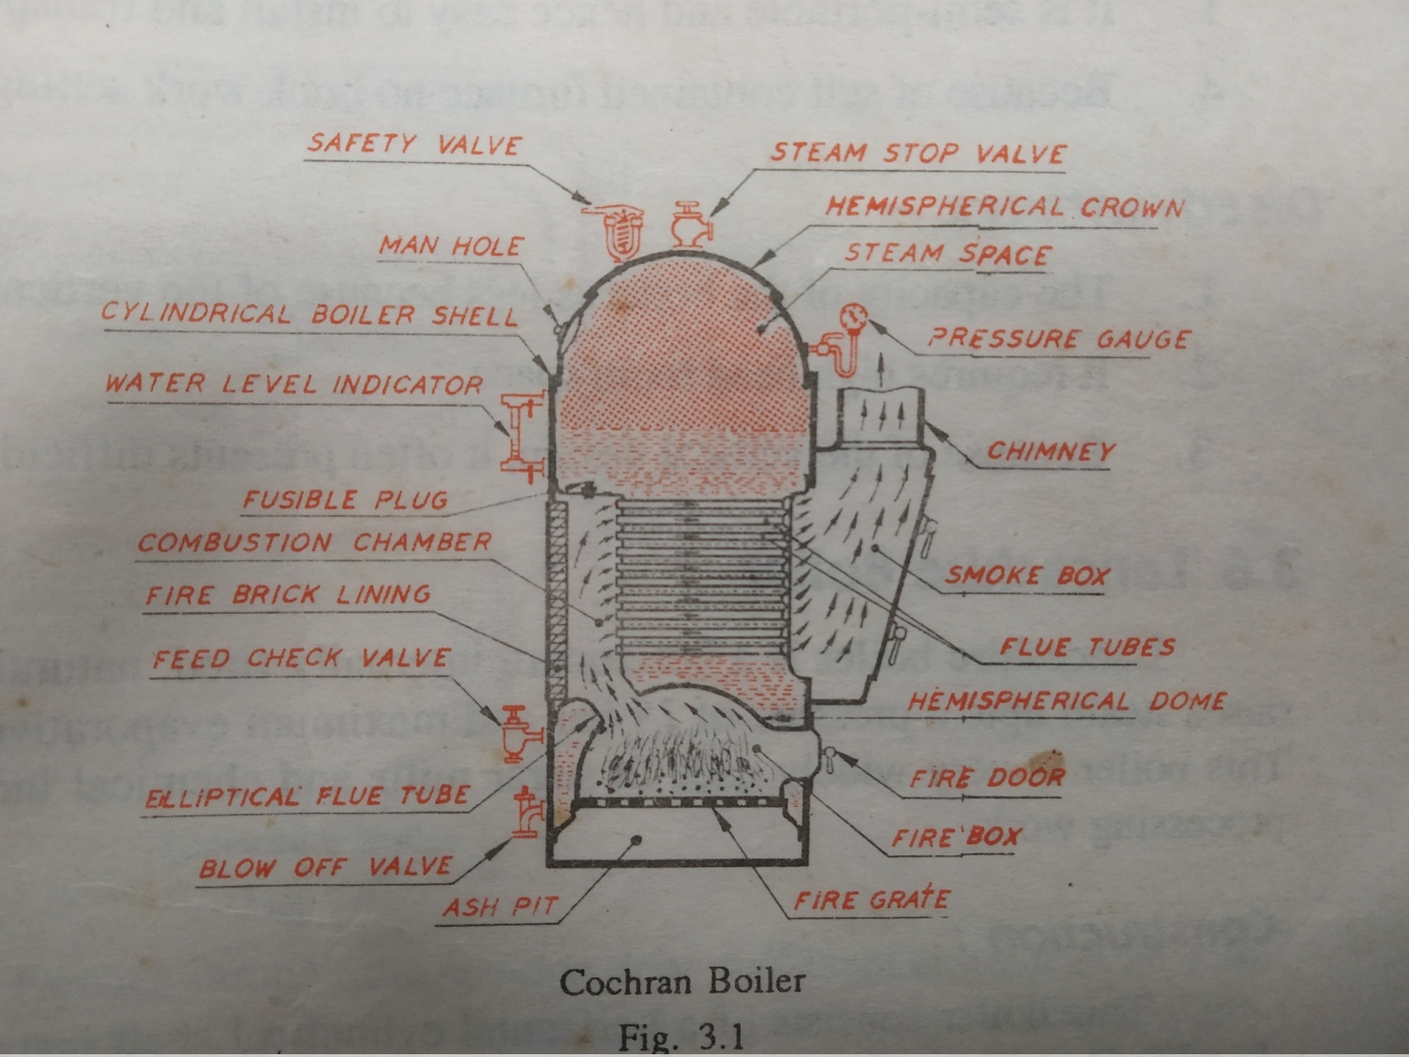
Cochran Boiler
A type of vertical, multi-tubular, internally fired, natural circulation, fire tube boiler.

Slide 5
Construction of Cochran Boiler
This boiler consists of a vertical cylindrical shell, fitted with a hemispherical crown at its top which forms the steam space, and a hemispherical dome which forms the fire box.
The platform over which the fuel burns is called fire gate. Beneath it is the ash pit which facilitates collection of ashes.
Fuel is charged through the fire door. The combustion chamber is lined with fire bricks which prevents over heating of the combustion chamber plate.
Number of flue tubes connect the combustion chamber and the smoke box. The chimney serves for the escape of gases.
The man hole facilitates inspection and repair of the interior of the boiler.

Slide 6
Working of Cochran Boiler
The boiler is filled with water to the specified level and maintained by charging with makeup water using a feed water pump. The flue tubes and the entire surface of the furnace except the openings are completely submerged under water.
The hot gases from the furnace along with unburnt volatile matter pass to the combustion chamber through the elliptical flue tube for complete combustion. They then pass through the horizontal flue tubes to the smoke box and escape to the atmosphere through the chimney.
The hot gasses while passing through the flue tubes transfer their heat to the water which is also heated in the furnace directly. The steam generated gets accumulated in the steam space.

Slide 7
Advantages and Disadvantages of Cochran Boiler
Advantages:
Occupies less floor space.
Cost of construction is low.
It is semi portable and hence easy to install and transport.
Because of self contained furnace no brick work is necessary.
Disadvantages:
The capacity of boiler is less because of vertical design.
It requires high head room space.
Difficult to clean and inspect because of vertical design.

Slide 8
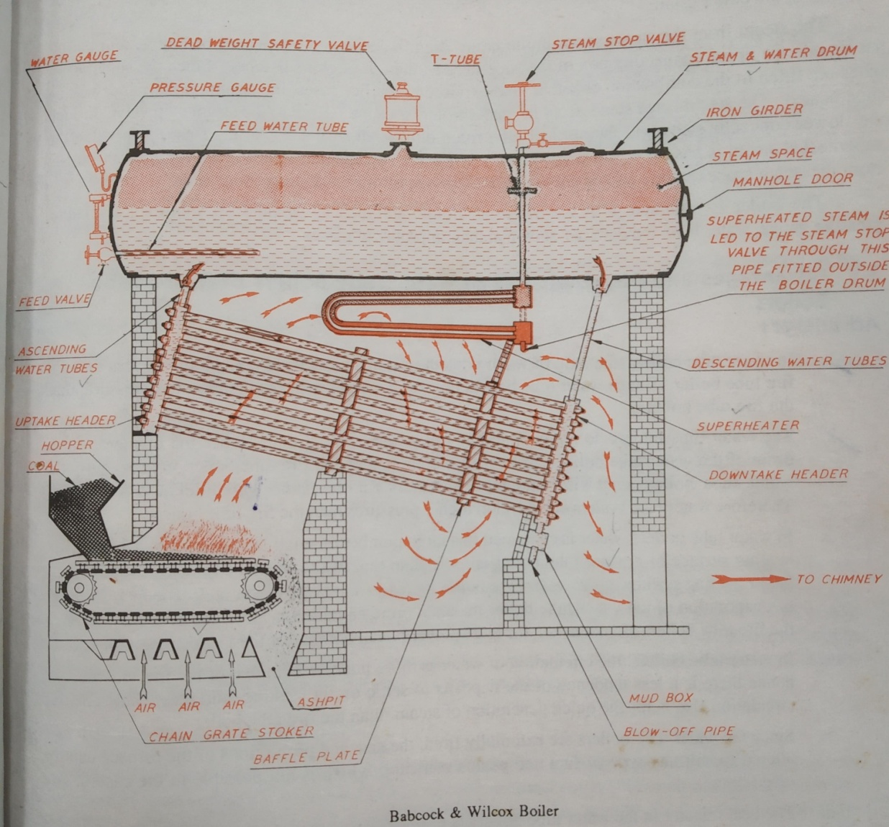
Babcock and Wilcox Boiler
A type of horizontal, externally fired, natural circulation, stationary, water tube boiler.

Slide 9
Construction of Babcock and Wilcox Boiler
The water and steam drum is suspended from iron girders resting on iron columns preventing unequal expansion.
A number of inclined water tubes are connected at right angles to the end boxes called headers. The water tubes are arranged in vertical rows of 4 to 5 one below the other in serpentine form. Each row is connected to two headers.
Each set of headers are connected to the boiler drum by one set of two tubes, one at the uptake and the other at the downtake end.
A mudbox is provided for collection of sediments.
The grate is provided at the front end. The coal fed on at the front end of the grate is burnt on the moving grate in the furnace.
The boiler is fitted with a superheater. It consists of a number of U – tubes secured at each end and placed below the boiler drum. The upper box is connected to a T-tube, the lower box is connected to the steam stop valve.

Slide 10
Working of Babcock and Wilcox Boiler
The water is introduced into the boiler drum through feed valve. A constant water level is maintained. Water descends into the rear end of the downtake headers and passes up in the inclined water tubes, uptake headers and connecting tubes.
Hot gases from the furnace grate are compelled by the baffle plate to pass upward around the water tubes lying in between the combustion chamber and under the water drum, the downwards around the water tubes in between the baffle plates, the once again upwards and then finally passes out through the exit door and chimney.

Slide 11
Boiler Mounting and Accessories
Essential Boiler Mountings:
Two water level indicators
Pressure Gauge
Two safety valves
Steam stop valve
Blow off cock
Feed Check valve
Fusible plug

Slide 12
Boiler Mounting and Accessories
Essential Boiler Accessories:
Economiser
Air preheater
Superheater
Feed pump
Steam Separator
Steam trap

Slide 13
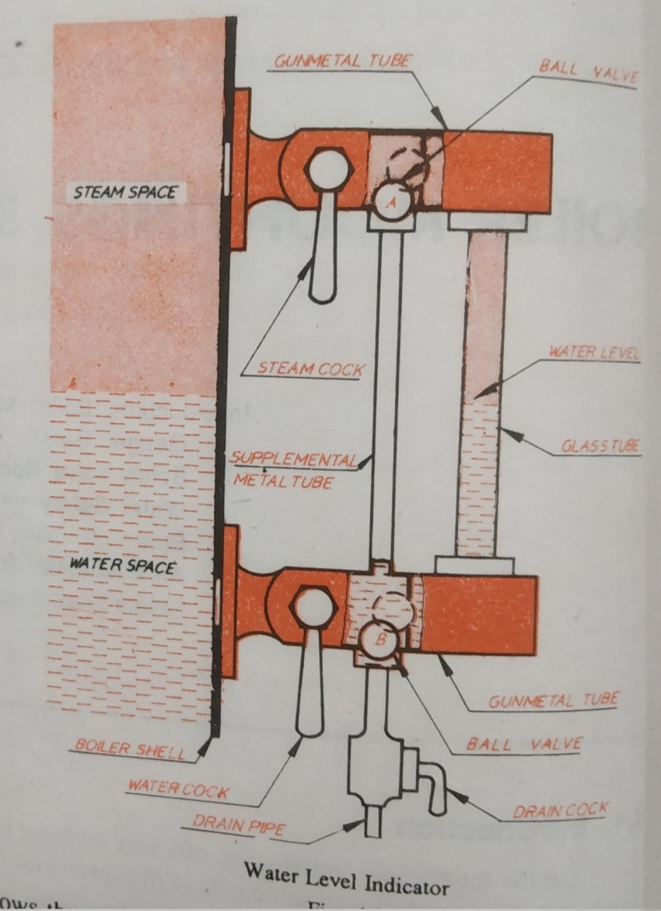
Water Level Indicator
Indicates the level of water in boiler drum

Slide 14
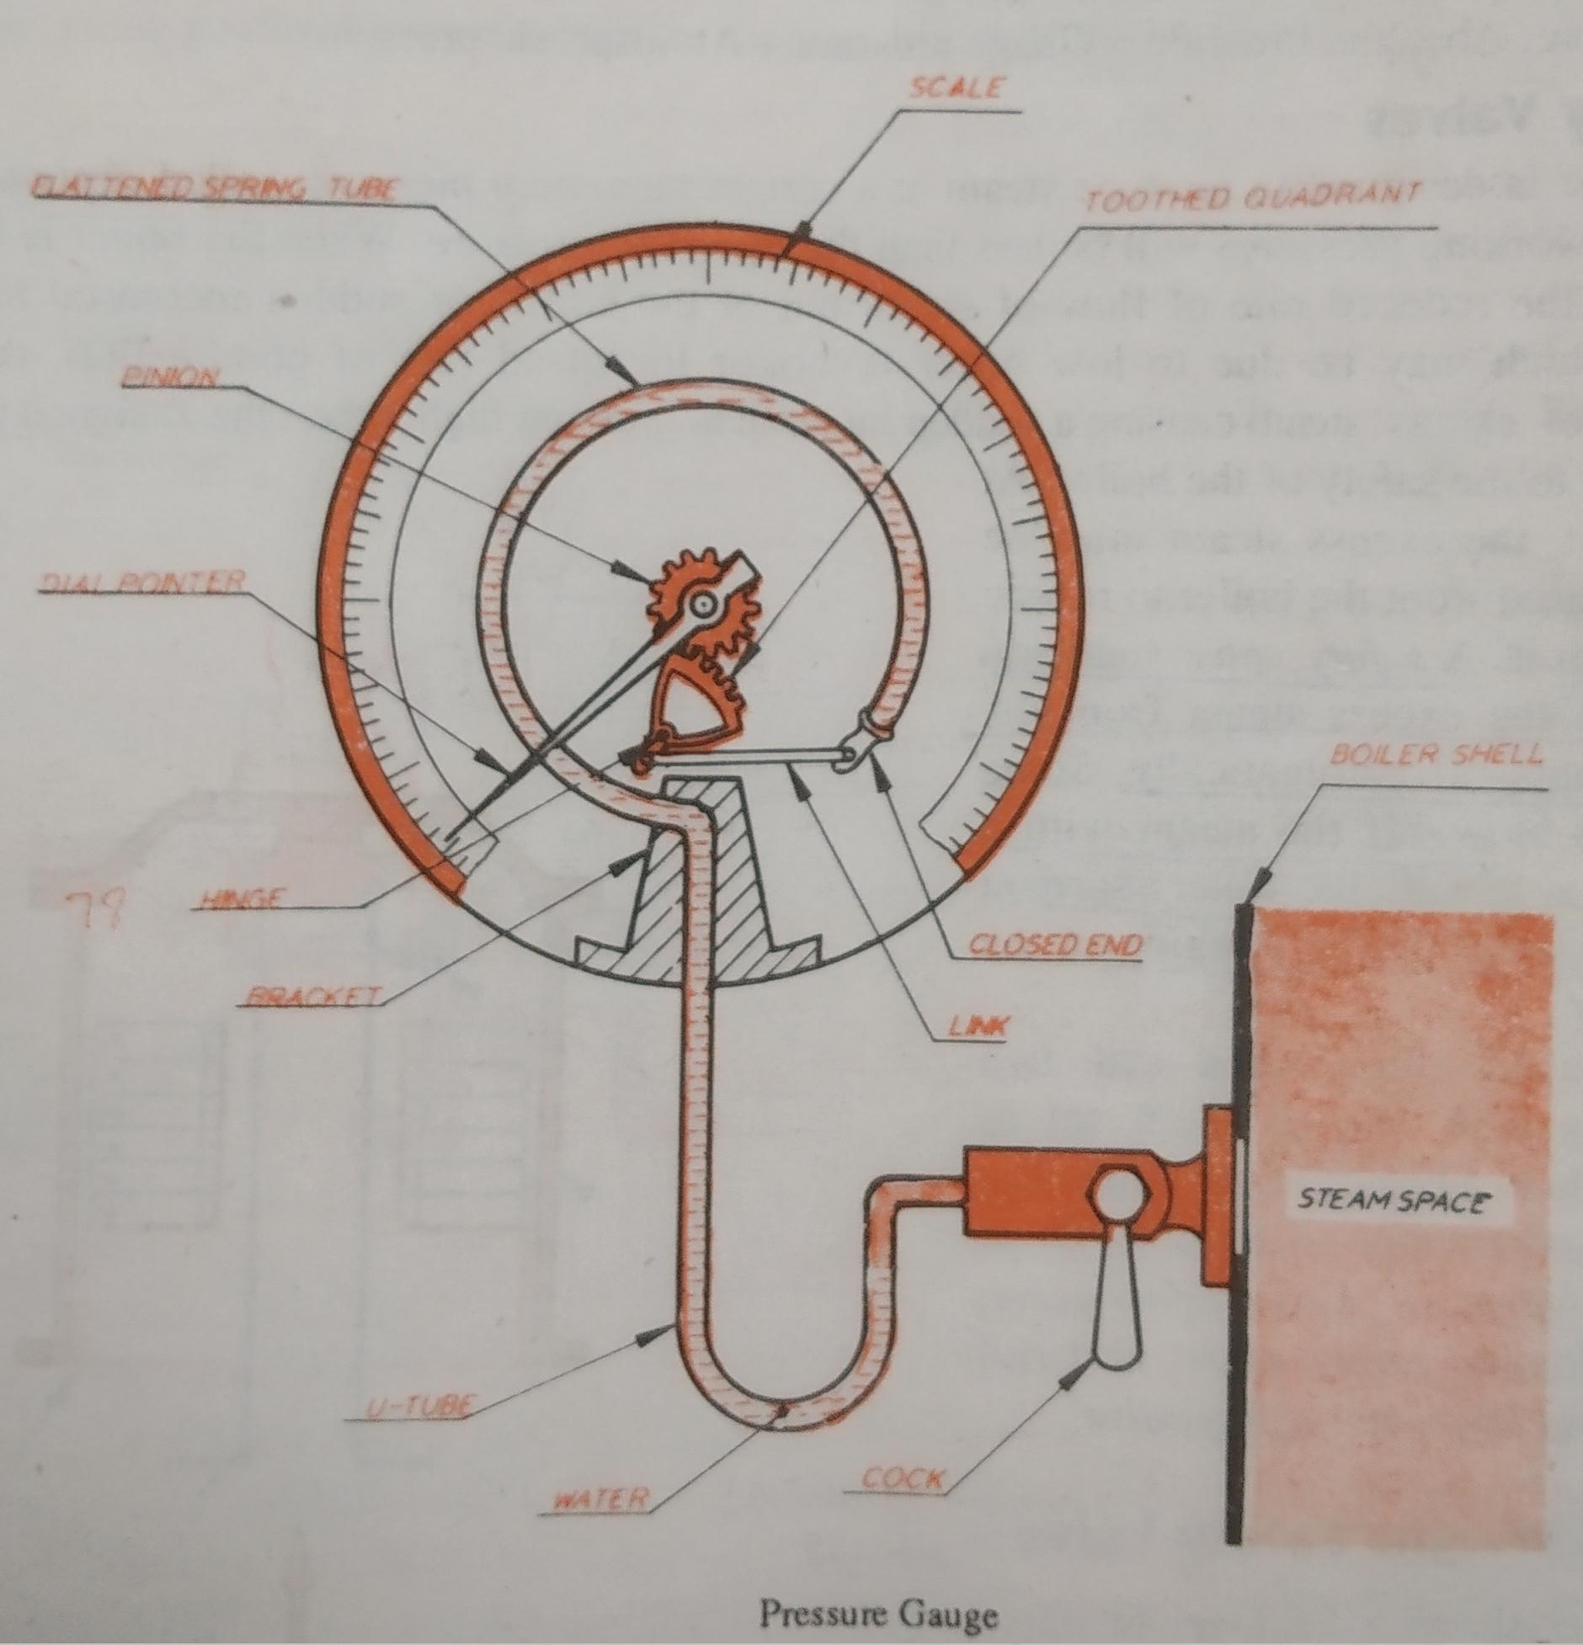
Pressure Gauge
Indicates the pressure of the steam in the boiler in bar or k Pa gauge

Slide 15
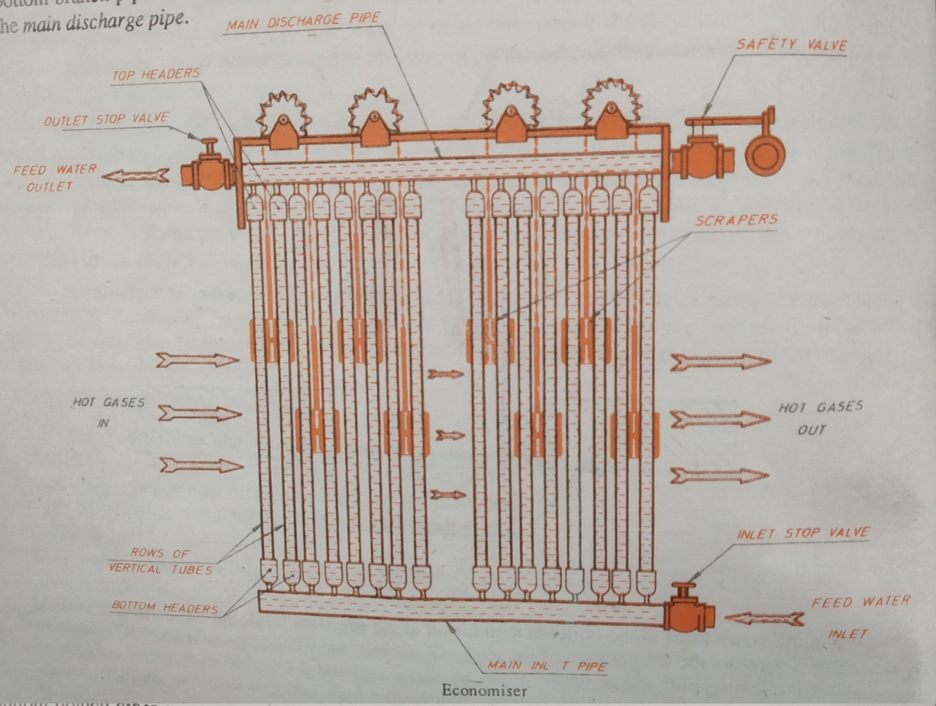
Economiser
The gases coming out from the boiler contain a large quantity of heat. The recovery of heat in the flue gas done by heating the feed water in economisers.

Slide 16
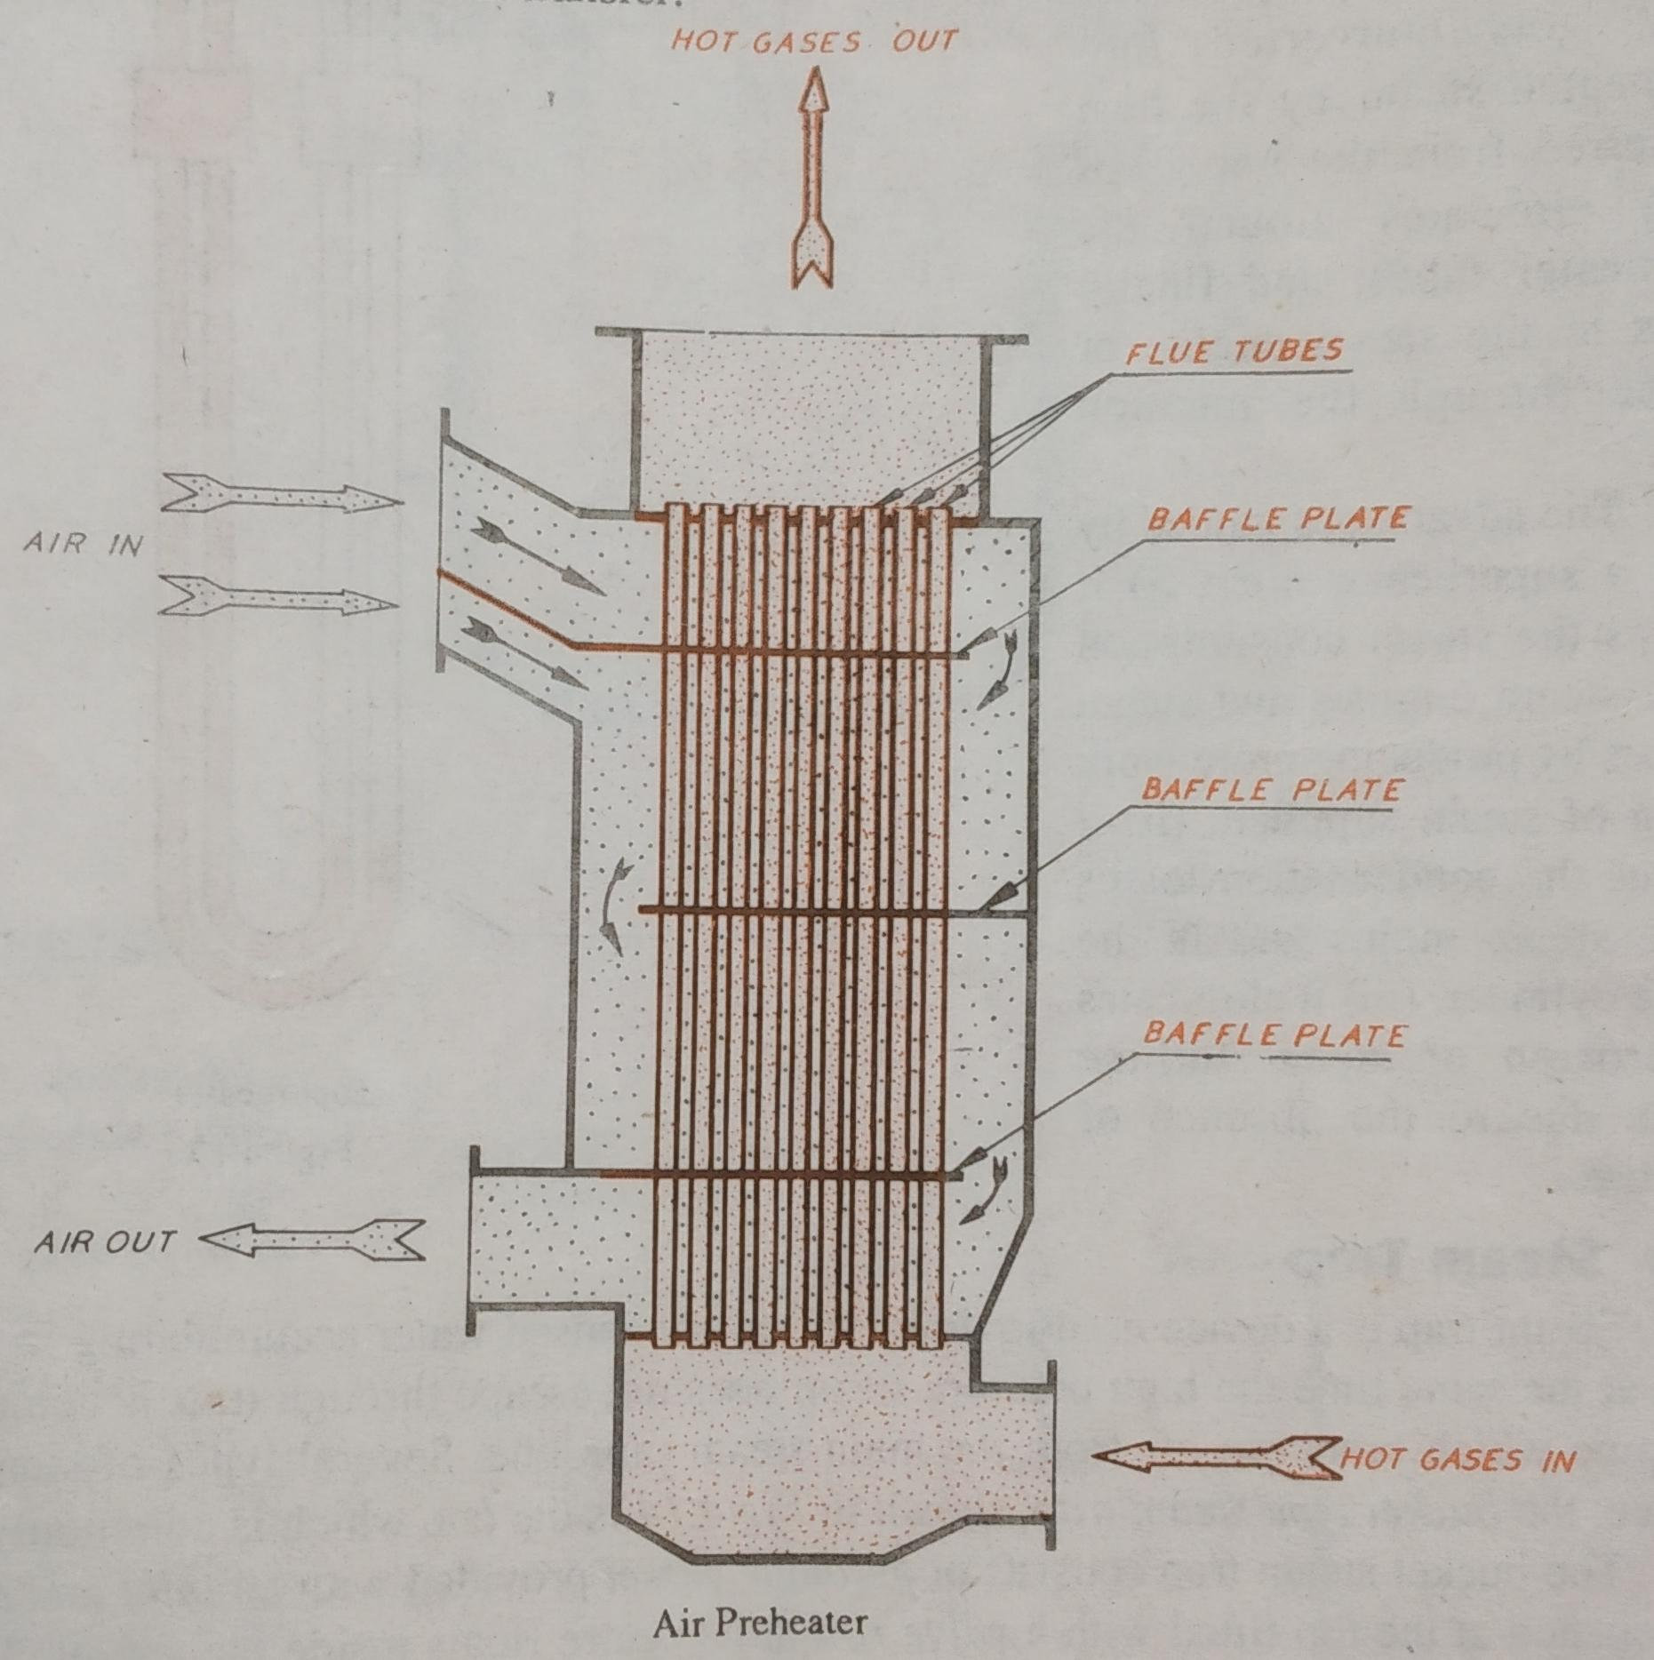
Air Preheater
It is installed between economiser and chimney.

Slide 17


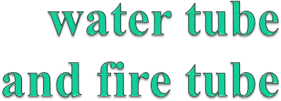
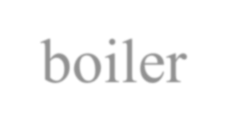
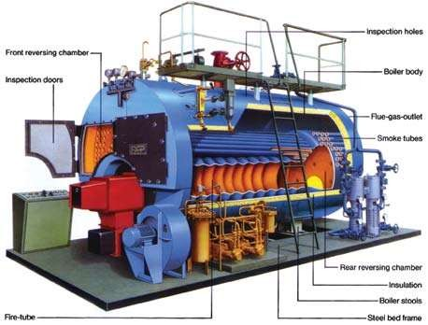
boiler

Slide 18
What
is
a
boiler?
Boiler is an apparatus to produce steam. Thermal energy
released by combustion of fuel is used to make
the desired temperature and pressure.
The steam produced is used for:
steam at
 (i) Producing mechanical work by expanding it in steam
engine or steam turbine.
 (ii) Heating the residential and industrial buildings
 (iii) Performing certain processes in the sugar mills, chemical and textile industries.

Slide 19





Introduction
STEAM TO
STACK DEAERATOR PUMPS
EC - N - ZER
^{VENT} BOILER
BURNER
SOURCE
BLOW DOWN
SEPARATOR FUEL
BRINE CHEMICAL FEED
SOFTENERS
Figure: Schematic overview of a boiler room
PROCESS
EXHAUST GAS
VENT
O
OMI
WATER

Slide 20
Boiler
properties
a). Safety: The boiler should be safe under the operating
conditions.
b). Accessibility: the various part of boiler should be accessible for repair & maintenance.
c). Capacity: Should be capable of supplying Steam
according to the requirements.
d). Efficiency: Should be able to absorb a maximum amount of heat produced due to burning of fuel in the furnace.
e). It should be simple in construction.
f). Its initial cost and maintenance cost is low.
g). It should be capable of quick starting and loading.

Slide 21

CLASSIFICATION
OF
BOILERS
TUBE

According to
what
flows
in
the


1. Water tube.
2. Fire tube.

Slide 22
Fire Tube Boilers
 The combustion gases pass inside boiler tubes, and heat transferred to water on the shell side.
• Relatively small steam capacities (12,000
kg/hour)
• Low to medium steam pressures (18 kg/cm2)
• Operates with oil, gas or solid fuels
is

Slide 23
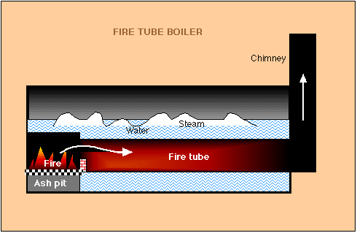
Fire Tube
Boilers

Slide 24
Water Tube
Boilers
 In this type of boiler water passes through the tubes while the
gases remain in the shell side, passing over the tube surfaces
• Used for high steam demand and pressure requirements
• Capacity range of 4,000 – 120,000 kg/hour
• Combustion efficiency enhanced by induced draft fans.
• Lower tolerance for water quality and needs water
treatment plant

Slide 25
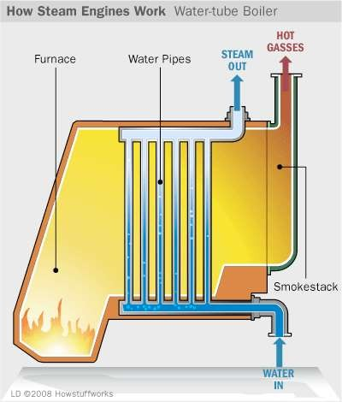
Water
tube
boilers

Slide 26
Comparison
between
Fire-tube
&
water-tube
boilers
S no. Particulars Fire tube boilers Water tube boilers
1. Mode of firing Internally fired Externally fired
2. Rate of steam production lower Higher
3. construction Difficult Simple
4. transportation Difficult Simple
5. Treatment of water Not so necessary More necessary
6. Operating pressure Limited to 16 bar Under high pressure as
100 bar
7. Floor area More floor area Less floor area
8. Shell diameter Large for same power Small same power
9. explosion Less More
10.
Risk of bursting
lesser
More risk

Slide 27
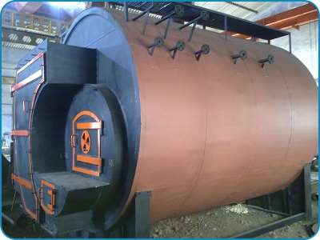
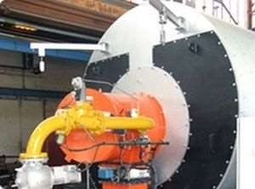
BOILER MAIN COMPONENTS
 BOILER SHELL- Theouter
cylindrical
portion of
a pressure
vessel.
BURNER
- A device
for the
introduction of fuel and air into a
furnace at the desired velocitie.The
burner is the principal device for the firing of oil and/or gas.

Slide 28
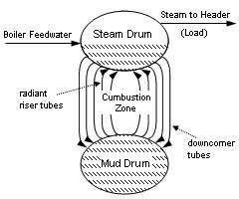
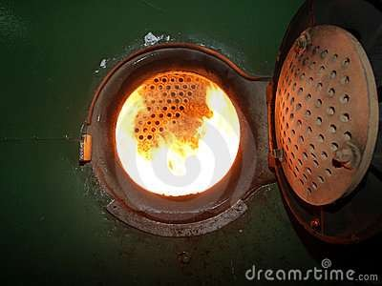
BOILER MAIN COMPONENTS
 Mud Ring or Mud Drum
 A typically cylindrical shaped space at the bottom of the water space. Sediment, mud, and other impurities gather there.
 FURNACE - An enclosed space
provided for the combustion of
fuel.

Slide 29
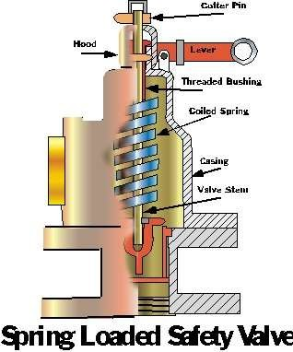
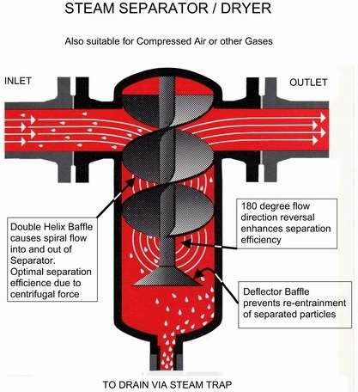
BOILER MAIN COMPONENTS
 SAFETY VALVE - A spring loaded
valve that automatically opens when pressure attains the valve setting. Used to prevent excessive pressure from building up in a boiler.
 STEAM SEPARATOR - A device
for removing the entrained water from steam.

Slide 30
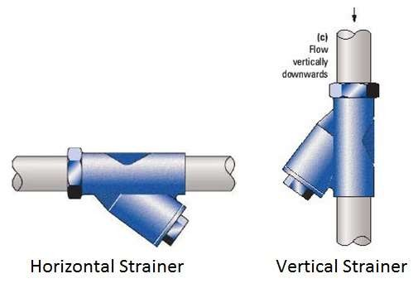
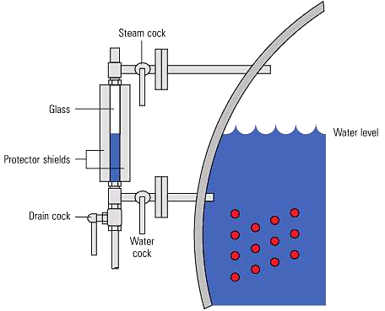
BOILER MAIN
COMPONENTS
 STRAINER - A device, such as a filter, to retain solid particles allowing a liquid to pass.
 SIGHT GLASS-
used on steam boilers to give a
visible indication of the boiler's water level

Slide 31
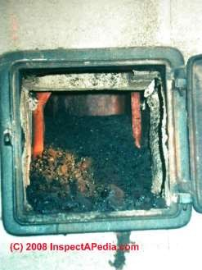
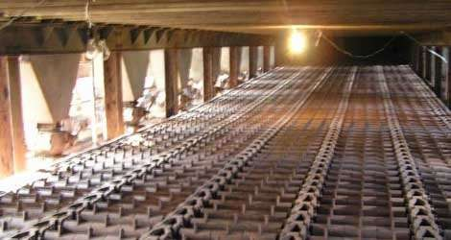
BOILER MAIN
COMPONENTS


Ash Pit
The ash pit is the space where
ashes accumulate under the
fire. The ashes fall through the
fire grate into a (often)
removable box.
Grate
The Grate is a series of bars or
narrow plates in the bottom of
the fire box. The ashes fall
through the grate into the ash
pit.



Slide 32
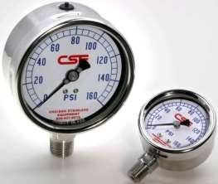
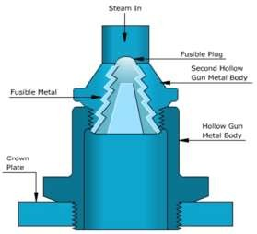
BOILER MAIN COMPONENTS
 Pressure Gauge. This
indicates the pressure of the
steam in the boiler.
 Fusible Plug . A fusible plug
operates as a safety valve when
dangerous temperatures,
rather than dangerous
pressures, are reached in a
closed vessel.

Slide 33
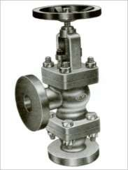
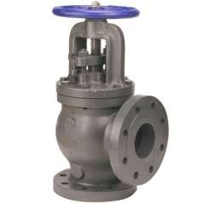
BOILER MAIN COMPONENTS

Feed Check Valve. The
high pressure feed water is
supplied to the boiler
through this valve. This
valve opens towards the
boiler only and feeds the
water to the boiler.
Steam Stop Valve.
It regulates the flow of steam supply outside.



Slide 34
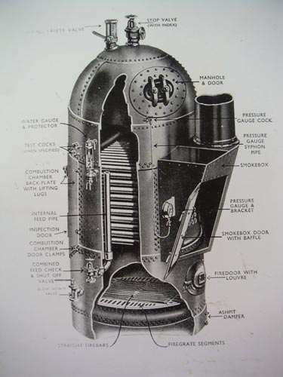
Type of fire tube boiler


Cochran Boiler
It is a multi-tubular vertical fire tube boiler having a number of horizontal fire tubes. This is the modification of a simple vertical boiler where the heating surface has been increased by means of a number of fire tubes.
It is very compact and requires minimum floor area.
Any type of fuel can be used with this boiler.
Well suited for small capacity
requirements.




Slide 35
Type of fire tube boiler
 Lancashire Boiler
 It is stationary fire tube, internally fired,
horizontal,
natural circulation boiler. This is a widely used boiler
because of its good steaming quality and its ability to
burn coal of inferior quality.
 This boiler is set in brickwork forming external flue so that the external part of the shell forms part of the heating surface.

Slide 36
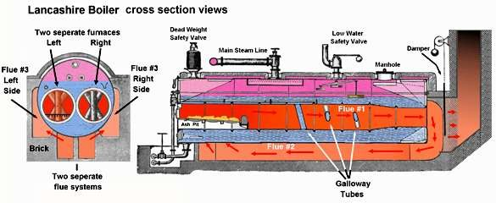
Lancashire Boiler

Slide 37
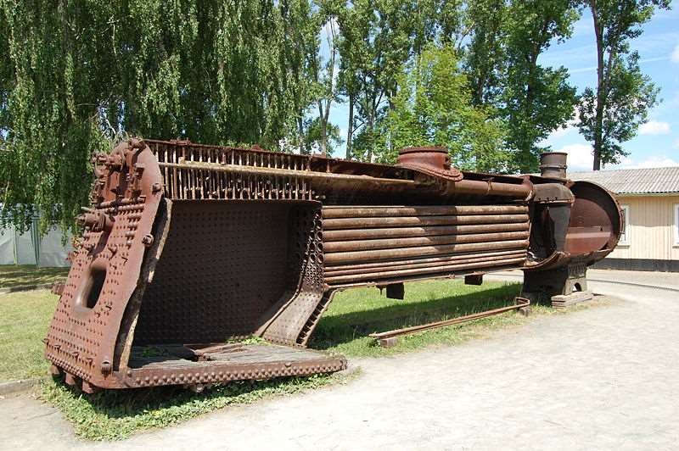
Type of fire
tube
boiler

LOCOMOTIVE
BOILER. Locomotive
boiler is a horizontal
fire tube type
mobile boiler. The main
requirement of this boiler is that it should produce steam at a very high rate. Therefore, this boiler requires a large amount of heating surface and large grate area to burn coal at
a rapid rate.


Slide 38
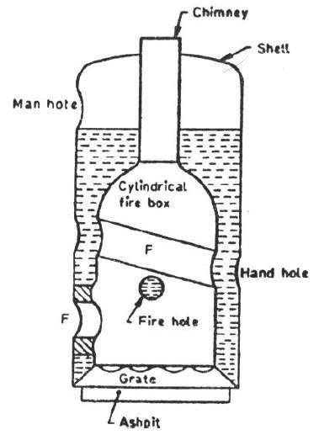
Type of water tube boiler


Simple vertical boiler
A vertical boiler is a type of water- tube boiler where the boiler barrel is oriented vertically instead of the more common horizontal orientation. Vertical boilers were used for a variety of steam- powered vehicles and other mobile machines, including early steam locomotives.

Slide 39
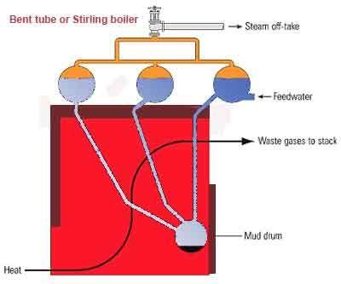
Type of water tube
boiler


Stirling boiler
The Stirling boiler is an early
form of water-tube boiler, used t
generate steam in large land-
based stationary plants.
Stirling boilers are one of the
larger arrangements for a water-
tube boiler. They consist of a
large brick-built chamber with a
sinuous gas path through it,
passing over near-vertical water-
tubes that zigzag between
multiple steam drums and mud
drums.
o


Slide 40
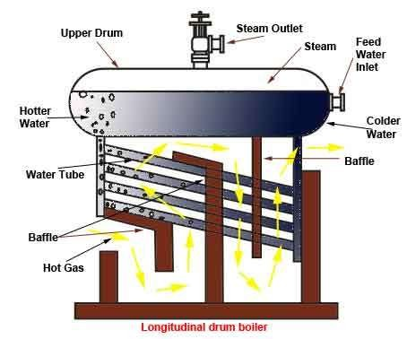
Type of water tube
boiler


Babcock and Wilcox boiler
The longitudinal drum boiler
is the generally accepted
standard of Babcock &
Wilcox construction. The
cross drum boiler, though
originally designed to meet
certain conditions of
headroom, has become
popular for numerous classes
of work where low headroom
is not a requirement which
must be met.

Slide 41


MERITS OF WATER TUBE BOILERS
OVERFIRE TUBE BOILERS
 1. Generation of steam is much quicker due to small
ratio of water content to steam content. This also helps
in reaching the steaming temperature in short time.
 2. Its evaporative capacity is larger and the steam
pressure range is also high-200 bar.
 3. Heating surfaces are more effective as the hot gases
travel at right angles to the direction of water flow.

Slide 42
MERITS OF WATER TUBE BOILERS
OVERFIRE TUBE BOILERS
 4. The combustion efficiency is higher because complete combustion of fuel is possible as the combustion space is much larger.
 5. The thermal stresses in the boiler parts are less as
different parts of the boiler remain at uniform temperature due to quick circulation of water.
 6. The boiler can be easily transported and easily its
different parts can be separated.

Slide 43
MERITS OF WATER TUBE BOILERS
OVERFIRE TUBE BOILERS
 7. Damage due to the bursting of water tube is less serious. Therefore, water tube boilers are sometimes called safety boilers.
 8. All parts of the water tube boilers are easily accessible
for cleaning, inspecting and repairing.
 9. The water tube boiler's furnace area can be easily
altered to meet the fuel requirements.

Slide 44
Demerits :
 1. It is less suitable for impure and sedimentary water, as small deposit of scale may cause the overheating and bursting of tube. Therefore, use of pure feed water is essential.
 2. They require careful attention. The maintenance costs are higher.
 3. Failure in feed water supply even for short period is
liable to make the boiler over-heated.
a

Slide 45


